Slide 1
Cryptography and System Security (CSS)
T.E – Sem.-VI
-Ms. Nabanita Mandal

Slide 2
Basic Terminology
plaintext - the original message
ciphertext - the coded message
cipher - algorithm for transforming plaintext/ciphertext
key - info used in cipher known only to sender/receiver
encipher (encrypt) - converting plaintext to ciphertext
decipher (decrypt) - recovering ciphertext from plaintext
cryptography - study of encryption principles/methods
cryptanalysis (codebreaking) - the study of principles/ methods of deciphering ciphertext without knowing key
cryptology - the field of both cryptography and cryptanalysis

Slide 3
Types of Cryptanalytic Attacks
ciphertext only
  know a) algorithm b) ciphertext
known plaintext
  know some given plaintext/ciphertext pairs
chosen plaintext
  select plaintext and obtain ciphertext
chosen ciphertext
  select ciphertext and obtain plaintext
chosen text
  select either plaintext or ciphertext to en/decrypt to attack cipher

Slide 4
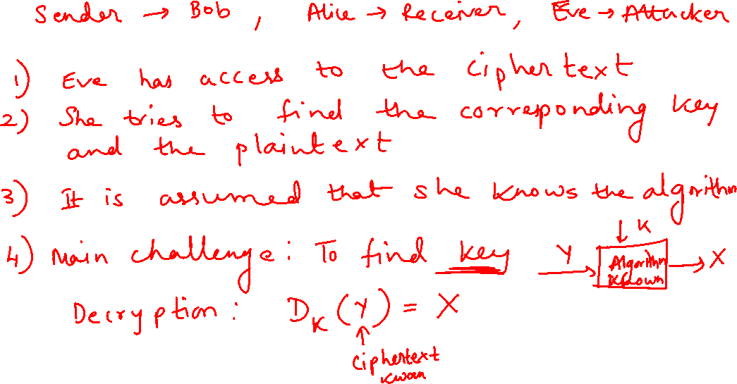
Ciphertext only Attack

Slide 5
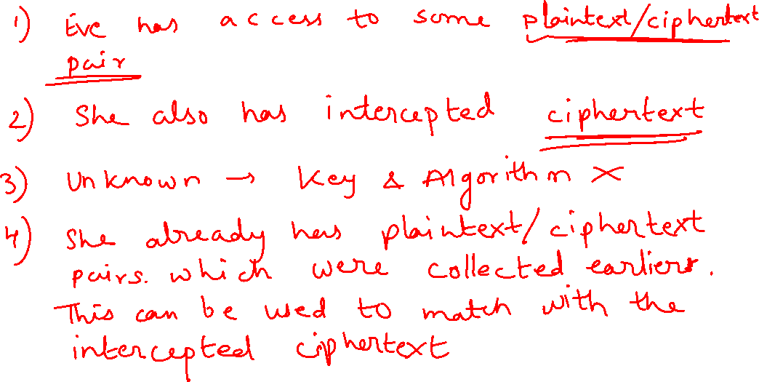
Known plaintext Attack

Slide 6
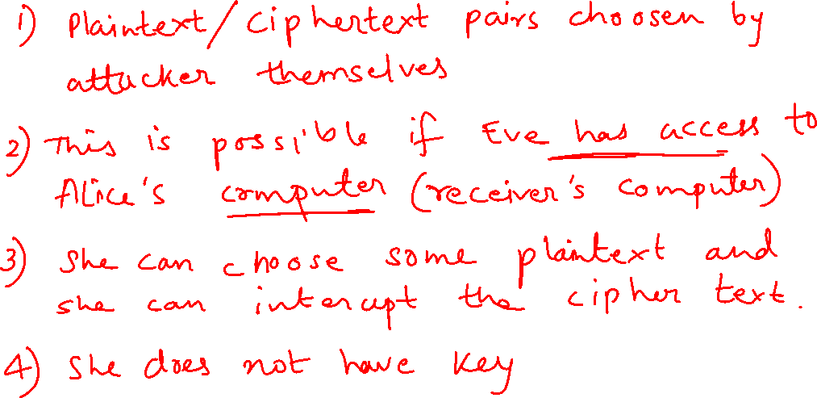
Chosen plaintext Attack

Slide 7
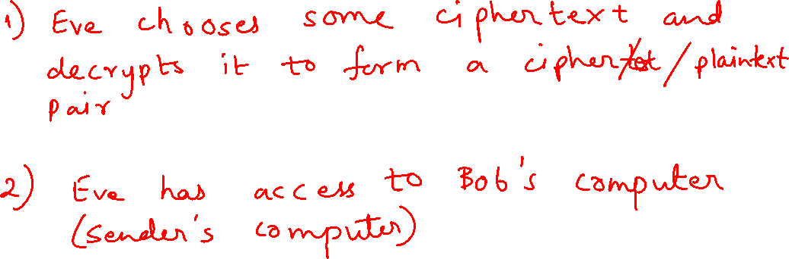
Chosen ciphertext Attack

Slide 8
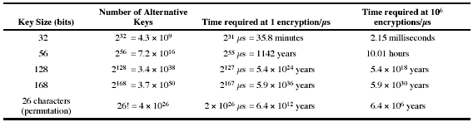
Brute Force attack
always possible to simply try every key
most basic attack, proportional to key size
assume either know / recognise plaintext

Slide 9
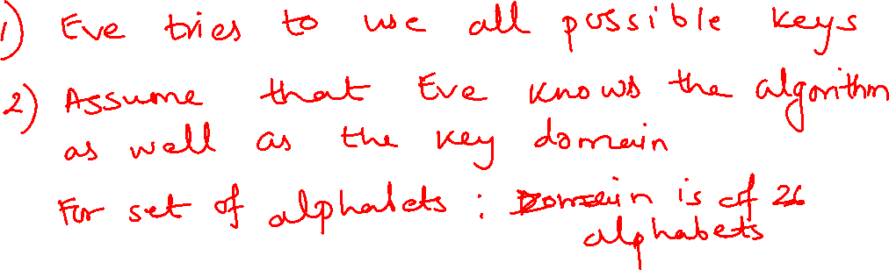
Brute Force attack

Slide 10
Statistical attack
A statistical attack attempts to exploit some statistical weakness in the cryptosystem such as a lack of randomness in key generation
Example: Letter ‘E’ is the most frequently used letter. The cryptanalyst finds the mostly used character in the ciphertext and assumes that the corresponding plaintext character is ‘E’. After finding a few pairs, he can find the key and use it to decrypt the message

Slide 11
Pattern attack
Some ciphers may hide the characteristics of the language but may create some patterns in the ciphertext
A cryptanalyst uses a pattern attack to break the cipher. Therefore it is important to use ciphers that make the ciphertext look as random as possible

Slide 12
More Definitions
unconditional security
  no matter how much computer power is available, the cipher cannot be broken since the ciphertext provides insufficient information to uniquely determine the corresponding plaintext (non-exist in real applications)
computational security
  given limited computing resources (e.g. time needed for calculations is greater than age of universe), the cipher cannot be broken
Notes:
Unconditional security would be nice, but the only known such cipher is the one-time pad (later). For all reasonable encryption algorithms, have to assume computational security where it either takes too long, or is too expensive, to bother breaking the cipher.

Slide 13
Cryptography
can be characterize by:
  type of encryption operations used
    substitution / transposition / product systems
  number of keys used
    single-key or private / two-key or public
  way in which plaintext is processed
    Block: process one block of elements a time
    Stream: continuous input, output one element a time

Slide 14
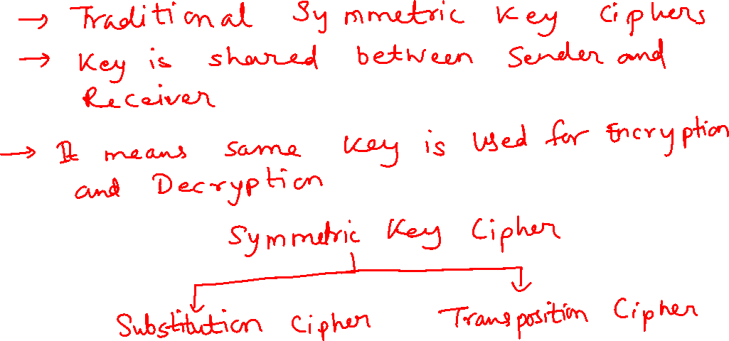
Classical or Traditional Ciphers
Notes:
In this section and the next, we examine a sampling of what might be called classical encryption
techniques. A study of these techniques enables us to illustrate the basic approaches to
symmetric encryption used today and the types of cryptanalytic attacks that must be anticipated.
The two basic building blocks of all encryption techniques: substitution and transposition.
We examine these in the next two sections. Finally, we discuss a system that combine both
substitution and transposition.

Slide 15
Classical Substitution Ciphers
In this, letters of plaintext are replaced by other letters or by numbers or symbols
or if plaintext is viewed as a sequence of bits, then substitution involves replacing plaintext bit patterns with ciphertext bit patterns
Notes:
In this section and the next, we examine a sampling of what might be called classical encryption
techniques. A study of these techniques enables us to illustrate the basic approaches to
symmetric encryption used today and the types of cryptanalytic attacks that must be anticipated.
The two basic building blocks of all encryption techniques: substitution and transposition.
We examine these in the next two sections. Finally, we discuss a system that combine both
substitution and transposition.

Slide 16
Substitution Ciphers
It can be categorized as:
  Monoalphabetic Cipher
    Additive Cipher
    Shift Cipher
    Caesar Cipher
    Multiplicative Cipher
    Affine Cipher
  Polyalphabetic Cipher
    Autokey Cipher
    Playfair Cipher
    Hill Cipher
    Vigenere cipher
Notes:
In this section and the next, we examine a sampling of what might be called classical encryption
techniques. A study of these techniques enables us to illustrate the basic approaches to
symmetric encryption used today and the types of cryptanalytic attacks that must be anticipated.
The two basic building blocks of all encryption techniques: substitution and transposition.
We examine these in the next two sections. Finally, we discuss a system that combine both
substitution and transposition.

Slide 17
Monoalphabetic Cipher
rather than just shifting the alphabet
could shuffle the letters arbitrarily
each plaintext letter maps to a different random ciphertext letter
hence key is 26 letters long
  Plain: abcdefghijklmnopqrstuvwxyz
  Cipher: DKVQFIBJWPESCXHTMYAUOLRGZN
  Plaintext: ifwewishtoreplaceletters
  Ciphertext: WIRFRWAJUHYFTSDVFSFUUFYA

Slide 18
Monoalphabetic Cipher Security
Now we have a total of 26! = 4 x 10^26 keys
with so many keys, you might think it is secure
  The simplicity and strength of the monoalphabetic substitution cipher dominated for the first millenium AD.
but it would be !!!WRONG!!!
  First broken by Arabic scientists in 9th century

Slide 19
Cryptanalysis
monoalphabetic substitution ciphers do not change relative letter frequencies
discovered by Arabian scientists in 9th century
calculate letter frequencies for ciphertext
compare counts/plots against known values
for monoalphabetic must identify each letter
  tables of common double/triple letters help
Notes:
The simplicity and strength of the monoalphabetic substitution cipher meant it dominated cryptographic use for the first millenium AD. It was broken by Arabic scientists. The earliest known description is in Abu al-Kindi's "A Manuscript on Deciphering Cryptographic Messages", published in the 9th century but only rediscovered in 1987 in Istanbul, but other later works also attest to their knowledge of the field.

Slide 20
Cryptanalysis
given ciphertext:
  UZQSOVUOHXMOPVGPOZPEVSGZWSZOPFPESXUDBMETSXAIZ
  VUEPHZHMDZSHZOWSFPAPPDTSVPQUZWYMXUZUHSX
  EPYEPOPDZSZUFPOMBZWPFUPZHMDJUDTMOHMQ
count relative letter frequencies (see text)
guess P & Z are e and t
guess ZW is th and hence ZWP is the
proceeding with trial and error finally get:
  it was disclosed yesterday that several informal but
  direct contacts have been made with political
  representatives of the viet cong in moscow

Slide 21
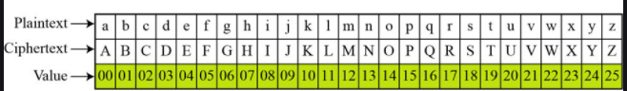
1. Additive Cipher
The plaintext consists of lowercase letters
The ciphertext consists of uppercase letters
Numerical values are assigned to each letter
Notes:
Substitution ciphers form the first of the fundamental building blocks. The core idea is to replace one basic unit (letter/byte) with another. Whilst the early Greeks described several substitution ciphers, the first attested use in military affairs of one was by Julius Caesar, described by him in Gallic Wars (cf. Kahn pp83-84). Still call any cipher using a simple letter shift a caesar cipher, not just those with shift 3.
Note: when letters are involved, the following conventions are used in this course: Plaintext is always in lowercase; ciphertext is in uppercase; key values are in italicized lowercase.

Slide 22
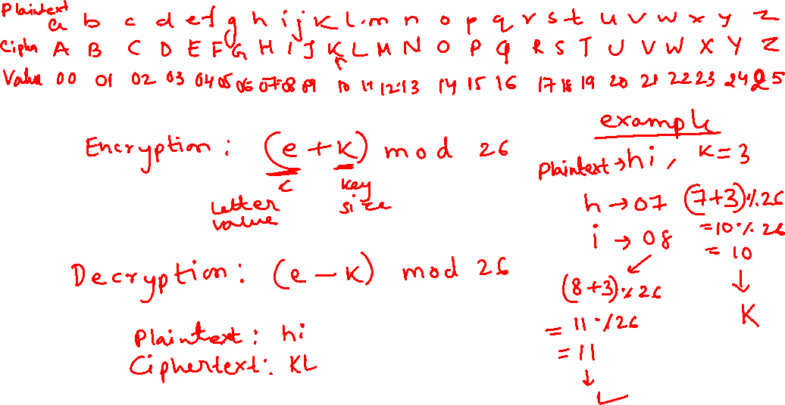
Additive Cipher
Notes:
Substitution ciphers form the first of the fundamental building blocks. The core idea is to replace one basic unit (letter/byte) with another. Whilst the early Greeks described several substitution ciphers, the first attested use in military affairs of one was by Julius Caesar, described by him in Gallic Wars (cf. Kahn pp83-84). Still call any cipher using a simple letter shift a caesar cipher, not just those with shift 3.
Note: when letters are involved, the following conventions are used in this course: Plaintext is always in lowercase; ciphertext is in uppercase; key values are in italicized lowercase.

Slide 23
2. Shift Cipher
Historically, additive ciphers are called shift ciphers
It is because the encryption algorithm can be interpreted as “shift key characters down” and decryption algorithm can be interpreted as “shift key characters up” and
Notes:
Substitution ciphers form the first of the fundamental building blocks. The core idea is to replace one basic unit (letter/byte) with another. Whilst the early Greeks described several substitution ciphers, the first attested use in military affairs of one was by Julius Caesar, described by him in Gallic Wars (cf. Kahn pp83-84). Still call any cipher using a simple letter shift a caesar cipher, not just those with shift 3.
Note: when letters are involved, the following conventions are used in this course: Plaintext is always in lowercase; ciphertext is in uppercase; key values are in italicized lowercase.

Slide 24
3. Caesar Cipher
earliest known substitution cipher
Used by Julius Caesar
first attested use in military affairs
replaces each letter by a letter three places down the alphabet
Notes:
Substitution ciphers form the first of the fundamental building blocks. The core idea is to replace one basic unit (letter/byte) with another. Whilst the early Greeks described several substitution ciphers, the first attested use in military affairs of one was by Julius Caesar, described by him in Gallic Wars (cf. Kahn pp83-84). Still call any cipher using a simple letter shift a caesar cipher, not just those with shift 3.
Note: when letters are involved, the following conventions are used in this course: Plaintext is always in lowercase; ciphertext is in uppercase; key values are in italicized lowercase.

Slide 25
Caesar Cipher
can define transformation as:
  a b c d e f g h i j k l m n o p q r s t u v w x y z
  D E F G H I J K L M N O P Q R S T U V W X Y Z A B C
mathematically give each letter a number
  a b c d e f g h i j k l m n o p q r s t u v w x y Z
  0 1 2 3 4 5 6 7 8 9 10 11 12 13 14 15 16 17 18 19 20 21 22 23 24 25
then have Caesar cipher as:
  C = E(p) = (p + k) mod (26)
  p = D(C) = (C – k) mod (26)
Notes:
This mathematical description uses modulo arithmetic (ie clock arithmetic). Here, when you reach Z you go back to A and start again. Mod 26 implies that when you reach 26, you use 0 instead (ie the letter after Z, or 25 + 1 goes to A or 0).
Example: howdy (7,14,22,3,24) encrypted using key f (5) is MTBID

Slide 26
Caesar Cipher
The Caesar cipher is defined as:
  C = E(p) = (p + k) mod (26)
  p = D(C) = (C – k) mod (26)
  modulo arithmetic: 1 = 27 mod 26, 3 = 29 mod 26
Notes:
This mathematical description uses modulo arithmetic (ie clock arithmetic). Here, when you reach Z you go back to A and start again. Mod 26 implies that when you reach 26, you use 0 instead (ie the letter after Z, or 25 + 1 goes to A or 0).
Example: howdy (7,14,22,3,24) encrypted using key f (5) is MTBID

Slide 27
Cryptanalysis of Caesar Cipher
only have 26 possible keys
  Could shift K = 0, 1, 2, …, 25 slots
could simply try each in turn
In that also, k=0 is useless so total 25 options to try
a brute force search
given ciphertext, just try all shifts of letters
do need to recognize when have plaintext
Test: break ciphertext
GCUA VQ DTGCM
Notes:
With a caesar cipher, there are only 26 possible keys, of which only 25 are of any use, since mapping A to A etc doesn't really obscure the message! cf. basic rule of cryptanalysis "check to ensure the cipher operator hasn't goofed and sent a plaintext message by mistake"!
Can try each of the keys (shifts) in turn, until can recognise the original message. See Stallings Fig 2.3 for example of search.
Note: as mentioned before, do need to be able to recognise when have an original message (ie is it English or whatever). Usually easy for humans, hard for computers. Though if using say compressed data could be much harder.
Example "GCUA VQ DTGCM" when broken gives "easy to break", with a shift of 2 (key C).

